Slide 1
Car Rental System
Muhammad Izham Bin Norhamadi (B032020039)

Slide 2
Introduction
Car Rental is a business service that allows for vehicles renting for a certain amount of time for a fee.
Ranges from various automobiles such as motorcycles, vans, and cars
Aim: to create a simple and user friendly system for users and car owners

Slide 3
Problem Statement
Rental car owners difficult to find customer without platform to advertise
Signing a contract can be time consuming
Hassle to keep record of rental cars
Difficult to find suitable cars

Slide 4
Scope
Modules
Login
Renting
Rent out
Vehicle List
Vehicle returning and invoice
Target User
Car owners
Travelers

Slide 5
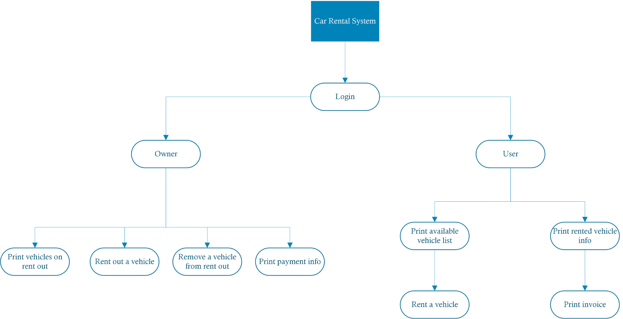
Structure Chart

Slide 6
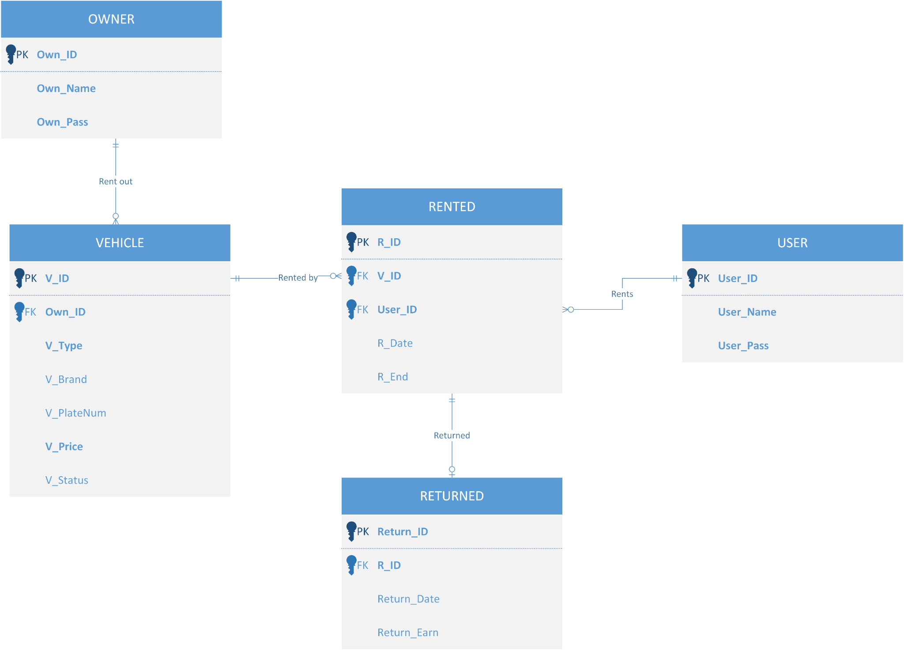
Entity Relationship Diagram

Slide 7
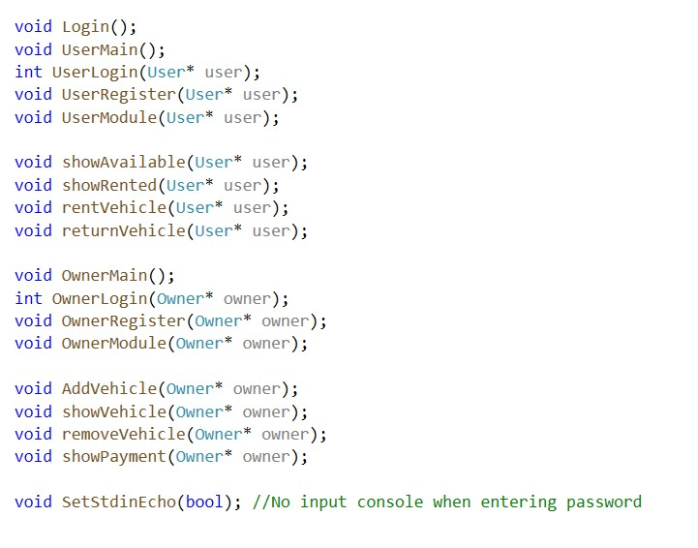
Implementation
Function

Slide 8
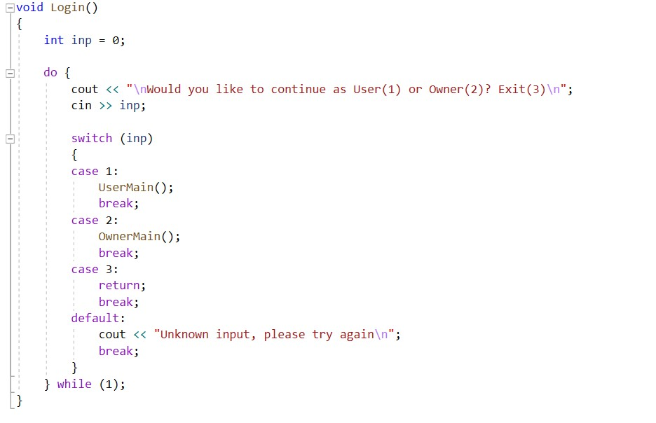
Selection

Slide 9
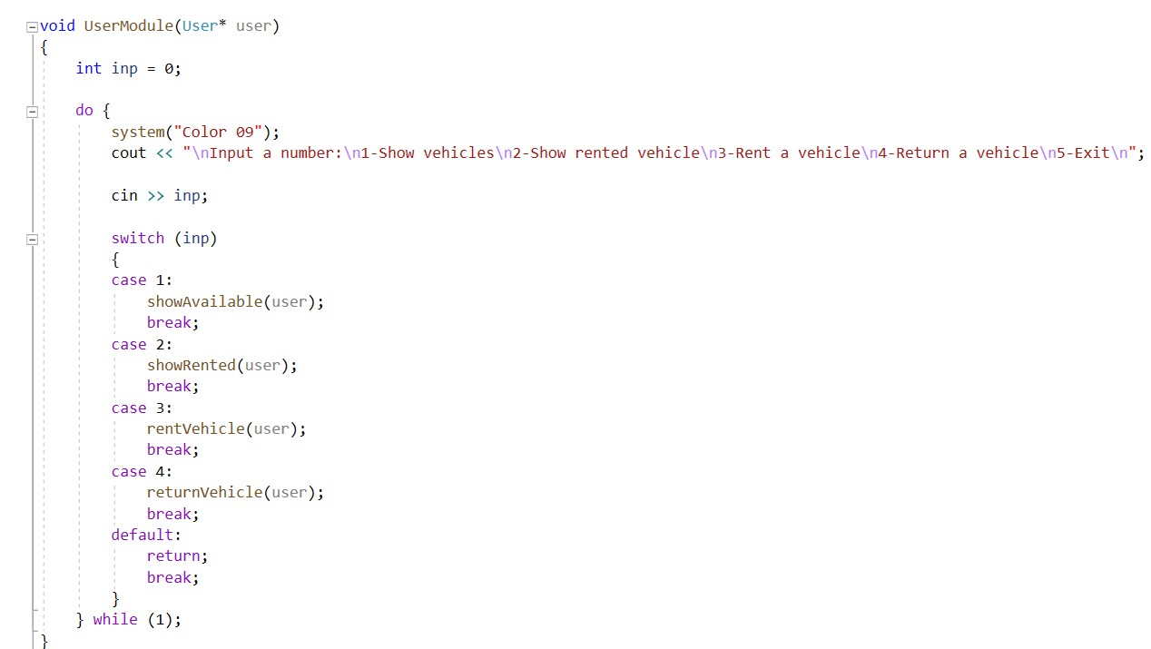
Control

Slide 10
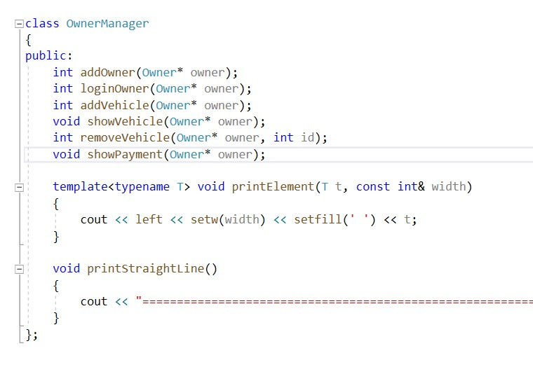
Class

Slide 11
Conclusion
Car Rental System features were successfully implemented
System Strengths and Weaknesses
Quick and Efficient
Too many menu navigation can be confusing
Suggestion for Improvement
Reduce amount of menu or upgrade to Graphical User Interface

